Slide 1

IOT PROJECT: FIRE ALARM TEAM: TECHBOYS MEMBERS: SANGAM CHATAPADHYAY SOUMITRA JANA SAGNIK CHAKROBORTI ROUNAK DAS
NETAJI SHUBHASH ENGINEERING COLLEGE

Slide 2
FIRE ALARM
Fire Detectors play a very important role in Industries, Shops, Malls, Residential complexes, parking areas etc. They help in detecting fire or smoke at an early stage and can help in saving lives. Commercial Fire detecting systems usually have an alarm signalling, with the help of a buzzer or Siren. We have designed an IOT based Fire Alerting System using Temperature and smoke sensor which would not only signal the presence of fire in a particular premise but will also send related information through IOT.

Slide 3
Acknowledgement
I would like to express my special thanks of gratitude to my teacher Rictor Bhowmik as well as our BES HOD Indranil Ghosh who gave me the golden opportunity to do this wonderful project on the topic FIRE ALARM on IOT, which also helped me in doing a lot of Research and i came to know about so many new things I am really thankful to them. Secondly i would also like to thank my parents and friends who helped me a lot in finalizing this project within the limited time frame.

Slide 4
ABSTRACT
Fire alarm systems are essential in providing an early warning in the event of fire. They help to save lives and protect property whilst also fulfilling the needs of insurance companies and government departments. Fire alarm systems typically consist of several inter-linked components, such as smoke detectors, heat detector, carbon monoxide, manual call points, sounders, alarm and buzzer. The fire alarm system should give immediate information in order to prevent the fire spread and protect live and property.

Slide 5
EQUIPMENTS
1. Arduino
2. ESP8266 wifi module with adapter
3. MQ-2 gas sensor
4. Green and Red LED
5. Buzzer
6. 220 ohm resistor
7. Connecting wires
8. Breadboard

Slide 6

CIRCUIT DIAGRAM

Slide 7
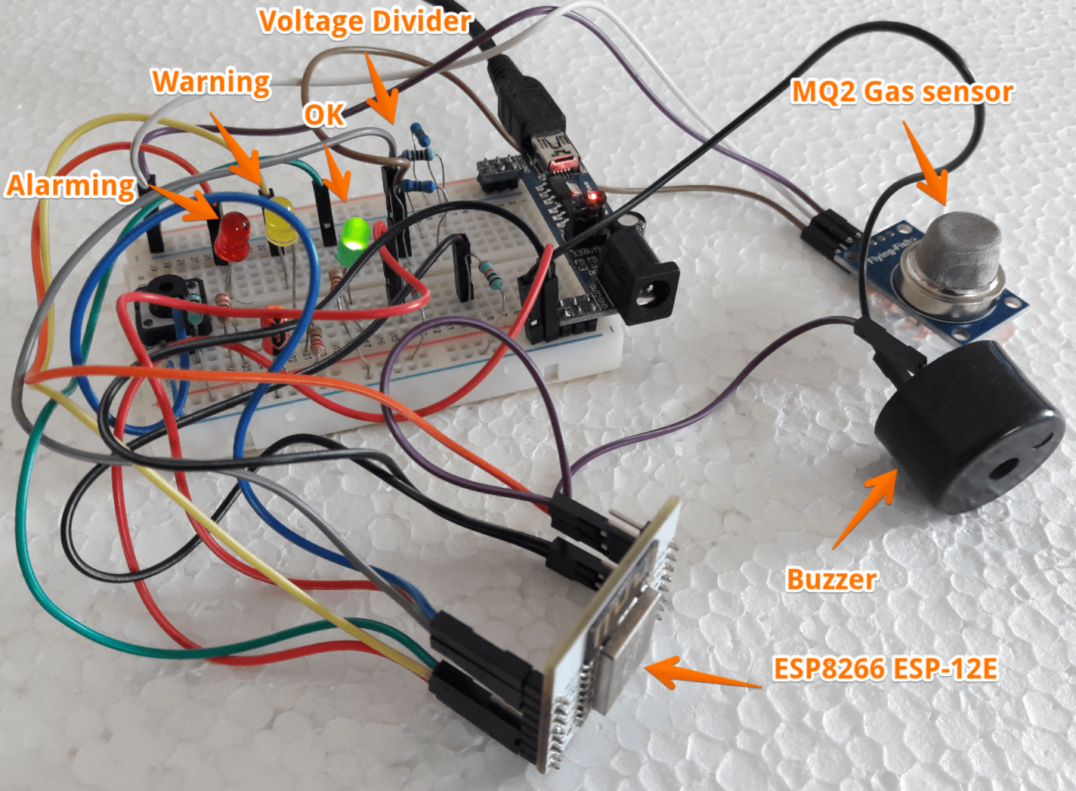
CIRCUIT DIAGRAM

Slide 8
ALGORITHIM
Step 1 : START
Step 2: Smoke and Temperature sensor senses the smoke and temperature value
Step 3 : If temperature and smoke level not greater than perticular value>>then no action taken
Step 4: If temperature and greater than perticular value>>warning messages are sent through emails
Step 5 : END

Slide 9
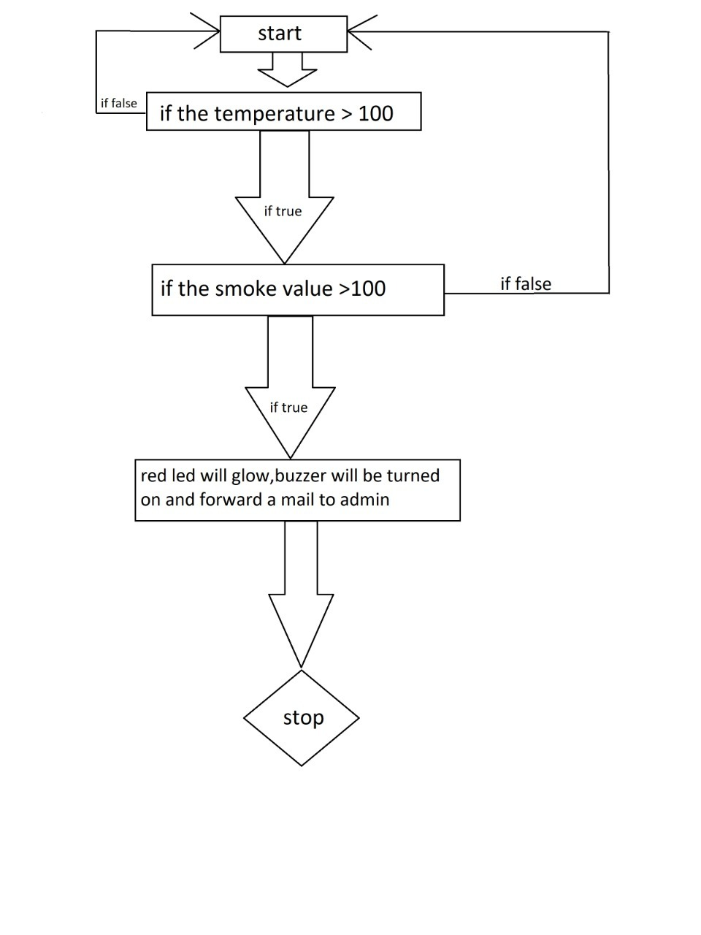
FLOWCHART

Slide 10
CODE EXPLANATION
First of all, add the software serial library. The software serial library will allow us to use the TX and RX communication on the Arduino's other pins rather than only using the default TX and RX pins. Then we defined that where we have connected these TX and RX pins on the Arduino. In the lines below, we have declared the pins for the LEDs, buzzer, and the smoke sensor.
In the setup function, first, we set the baud rate for the serial communication and for the wifi module at 9600. Then we declared the led pins and the buzzer pin as the output pins because we will give the output from these pins to the LEDs and the buzzer. Last, we declared the smoke sensor pin as the input because the smoke sensor pin will take the input from the sensor and will give it to the Arduino.
The lines will call the function and will set up a server at an IP address provided by the ESP. The ESP will then send the data at this IP address.

Slide 11
In the loop function, we read the values from the smoke sensor and then applied a condition that if the output value is greater than 400, then the red LED will light and the buzzer will start to beep. If the output value is less than 400, then the green LED will light up and the buzzer will remain quiet.
The code below will send the commands to the ESP and will print the output of the ESP on the serial monitor.

Slide 12
APPLICATION OF PROJECT
Fire alerting system have a wide range of applications.
IOT based fire alarm system using arduino can be used in Chemical Factories, Shopping Malls, local shops, Educational institutes, Parking Areas, Companies etc.
IoT Based Fire alarm Notification System Using WiFI can be used as a pre-cautionary measure at all the places listed above, which can help in notifying the fire departments early. If appropriate and immediate action is taken as soon as the buzzer turns ON, it can help in avoiding an accident.

Slide 13
REFERENCES
SPECIAL THANKS TO OUR TRAINER RICTOR BHOWMICK
WIKIPEDIA
GOOGLE
OTHER URLs- 1. https://maker.pro/arduino/projects/iot-smoke-alarm-arduino-esp8266-gas-sensor
2. https://www.projectsof8051.com/iot-based-fire-alerting-system-project/

